Slide 1







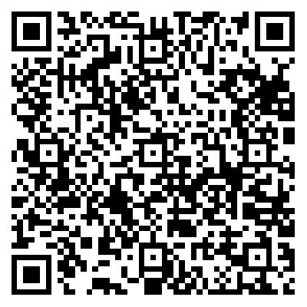
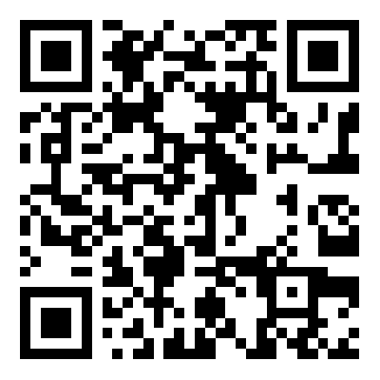

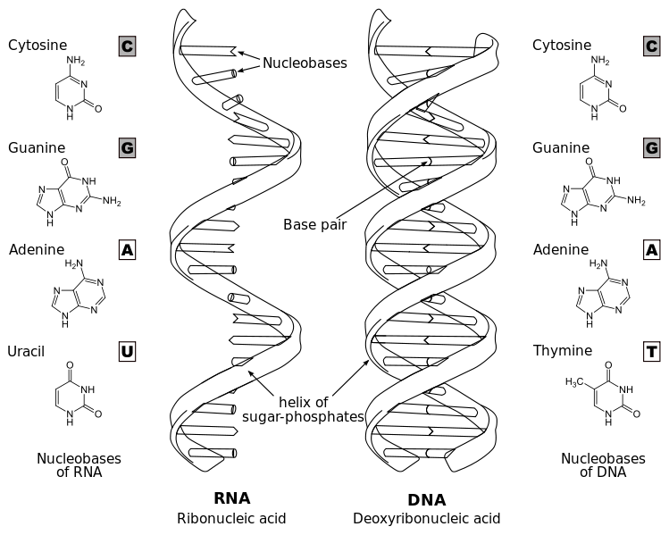
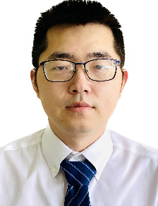
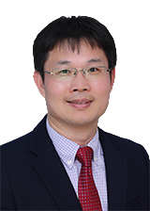
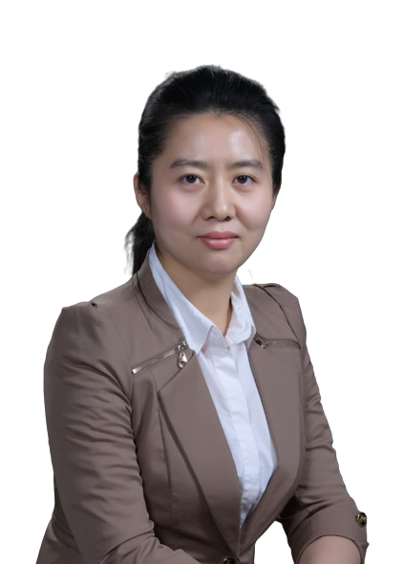


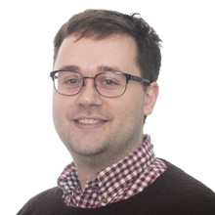
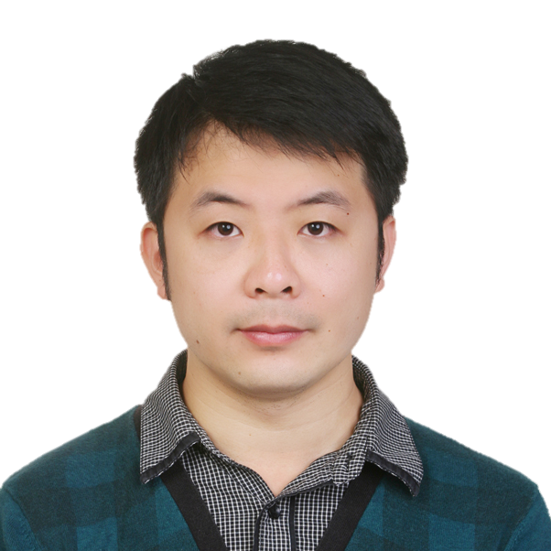
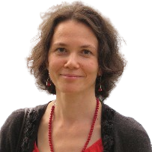

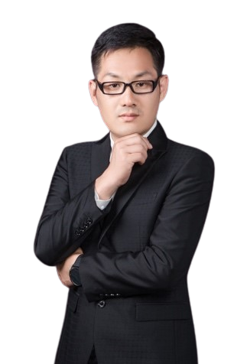
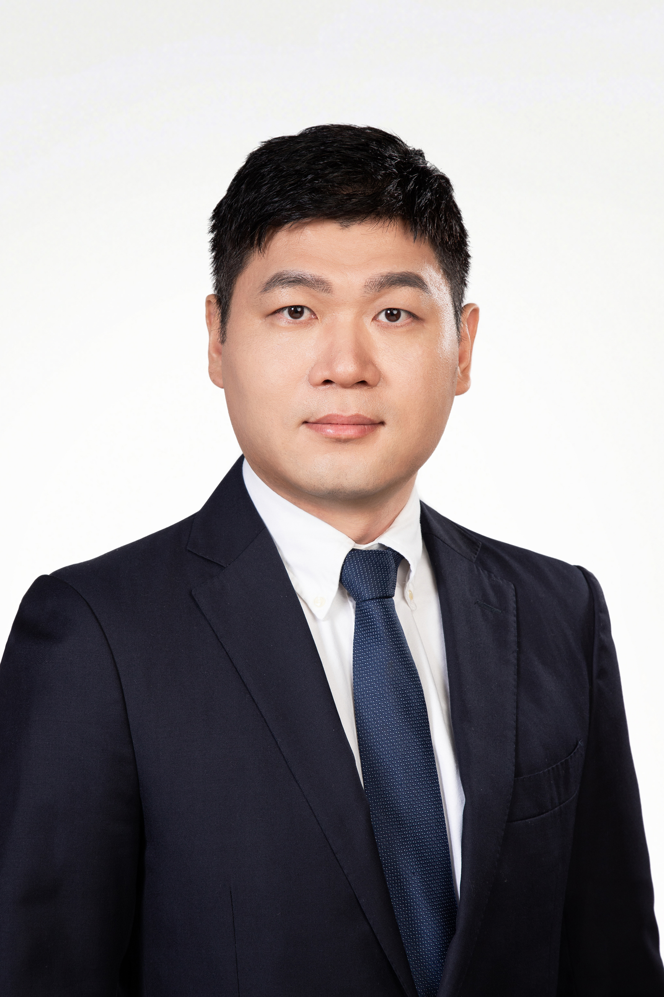
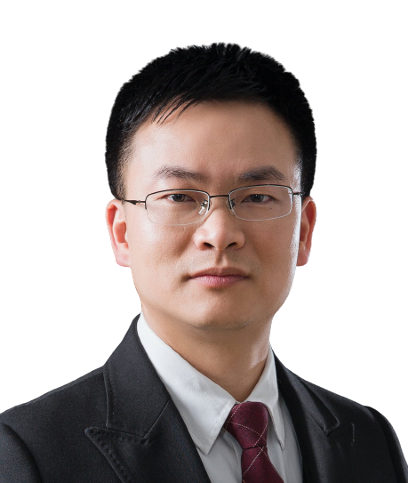
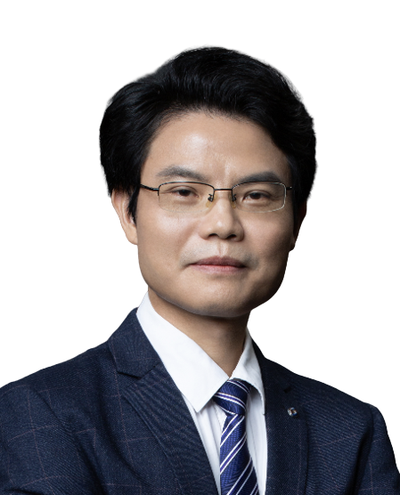
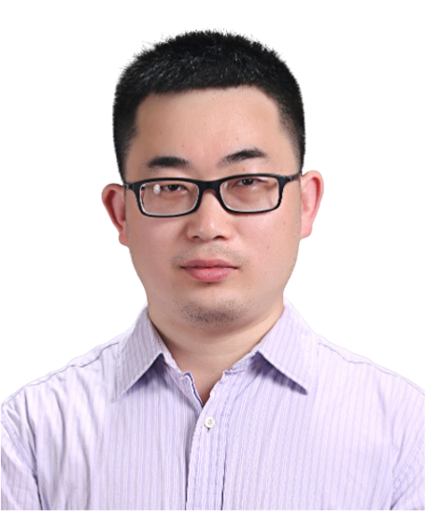
Guangzhou RNA club
2024 online symposium
Time： 10th July 2024
Zoom: https://us06web.zoom.us/j/82220005195?pwd=Av3ogDbYghN2AqprdUoPzdxEhQa0XH.1
(passcode: 123456)
Bilibili：https://live.bilibili.com/26427894
Zoom
Bilibili
Speakers
Robert T. Batey
University of Colorado Boulder
Title: A mechanistic perspective on how small molecules drive mRNA expression by riboswitches
Time：9:00 am Beijing/ 8:00 pm Boulder 9th July
Jian Wang
The Pennsylvania State University
Title: RNA 3D structure prediction: From traditional to machine learning techniques
Time：10:00 am Beijing / 10:00 pm Penn state 9th July
Chaoyong Yang
Xiamen University
Title: Spatial transcriptome sequencing resolves the tumour microenvironment
Time：11:00 am Beijing
Jie Ren
Beijing Institute of Genomics Chinese Academy of Sciences
Title: Nascent RNA at the crossroad of transcription and replication
Time：2:00 pm Beijing
Pascal Auffinger
University of Strasbourg
Title: Principles of ion binding to RNA
Time：3:00 pm Beijing / 9:00 am Strasbourg
Blake Sweeney
European Bioinformatics Institute
Title: RNAcentral and Rfam: Key resources for ncRNA science
Time：4:00 pm Beijing / 9:00 am Cambridge
Xi Chen
Nanjing University
Title: In vivo self-assembled small RNA is the new generation of RNAi therapeutics
Time：6:00 pm Beijing
Olga Soutourina
Université Paris-Saclay
Title: RNomics during Clostridioides difficile infection cycle: from identification to function
Time：7:00 pm Beijing / 1:00 pm Paris
Huabing Li
Chongqing Medical University
Title: Regulation of T cell function by RNA modification
Time：8:00 pm Beijing
HOSTS
Zhichao Miao
Guangzhou Laboratory
Guangzhou Medical University
Lin Huang
Sun Yat-Sen Memorial Hospital
Jianhua Yang
Sun Yat-Sen University
Jinkai Wang
Sun Yat-Sen University
Sponsors

